Slide 1
Unit 10
Teacher: Iddo Sadeh

Slide 2
In order to understand recursion, one must understand recursion
Recursion is when you call your program, in your program.
An example of recursion in nature is the idea of a tree branch. A tree branch consists of a stem and a set of other smaller branches. These smaller branches also have a stem and even more small branches, and so on and so forth. Blood vessels or rivers also hold a similar pattern.

Slide 3
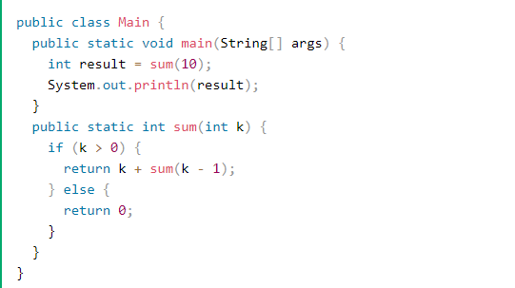
Recursion is when a method calls itself.
*code taken form https://www.w3schools.com/java/java_recursion.asp

Slide 4

Recursive methods contain at least one base case, which halts the recursion, and at least one recursive call
*code taken from https://csawesome.runestone.academy/runestone/books/published/csawesome/Unit10-Recursion/topic-10-1-recursion-day1.html
Notes:
10-1-2
10-1-3
10-1-12
10-1-13
https://csawesome.runestone.academy/runestone/books/published/csawesome/Unit10-Recursion/topic-10-1-recursion-day1.html
Do questions 1-3 in lab

Slide 5

Searching and sorting
Notes:
In Unit 7, we learned about two search algorithms, linear search and binary search.

Slide 6

Each recursive call has its own set of local variables, including the formal parameters.
Notes:
Each recursive call has its own set of local variables, including the formal parameters.
Parameter values capture the progress of a recursive process, much like loop control variable values capture the progress of a loop.
https://cscircles.cemc.uwaterloo.ca//java_visualize/#mode=display

Slide 7
recursion
Recursion is when a method calls itself.
Recursive methods contain at least one base case, which halts the recursion, and at least one recursive call.
Each recursive call has its own set of local variables, including the formal parameters.
Parameter values capture the progress of a recursive process, much like loop control variable values capture the progress of a loop.
Any recursive solution can be replicated through the use of an iterative approach.
Recursion can be used to traverse String, array, and ArrayList objects.

